Slide 1
Astro 331 Lesson 30
Verification & Validation (V&V)
Supp Crs Mtl

Slide 2
Lesson Objectives
Understand the difference between verification and validation
Describe the objective of the product verification process
List and describe the four types of verification
Understand that any anomalies or discrepancies with test data must be captured in verification evidence, along with any corrective actions that result from those findings
Describe the objective of end-to-end system testing
Describe the objectives of the product validation process
Understand the term “root cause analysis,” interpret an Ishikawa (“fishbone”) diagram and explain when it would be used

Slide 3
Verification & Validation

Slide 4
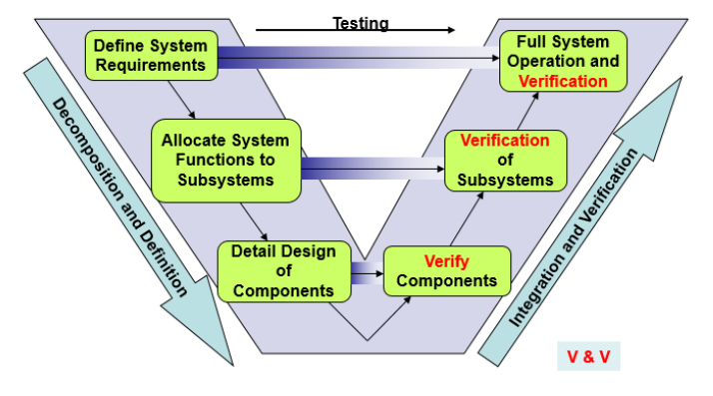
Systems Engineering “V” Model

Slide 5
Definitions
Verification: process that proves that a realized product conforms to its requirements
Asks the question: “Was the end product realized right?”
Validation: process that confirms that the realized end products conform to stakeholder expectations
Asks the question: “Was the right end product realized?”
Key Differences:
Verification derives test standards from requirements document
Validation derives test standards from ConOps document

Slide 6
Verification Process (1/2)
Objective: to generate evidence necessary to confirm that end products, from the lowest level of the system structure to the highest, conform to the specified requirements
Key Outputs:
Discrepancy reports and identified corrective actions
Verified product to validation or integration
Verification report and any required updates to requirements/compliance documentation

Slide 7
Verification Process (2/2)
Success criteria:
Documented objective evidence of compliance (or waiver, as appropriate) of each requirement
Closure of all discrepancy reports

Slide 8
Verification Methods
Four verification methods:
Analysis: use of modeling & simulation
Often used for ADCS, Structures and TCS
Demonstration: showing that use of product achieves requirement
Used for requirements that do not require intense data gathering (“shall be able to rotate 90 degrees”)
Inspection: visual examination
Used to verify simple requirements (“shall have a RBF tag”)
Test: obtaining detailed performance data
Most requirements
*Can use a combination of verification methods to verify a requirement
eg: Structures performs static loading, vibe and acoustic tests and then correlates those results back to detailed models

Slide 9
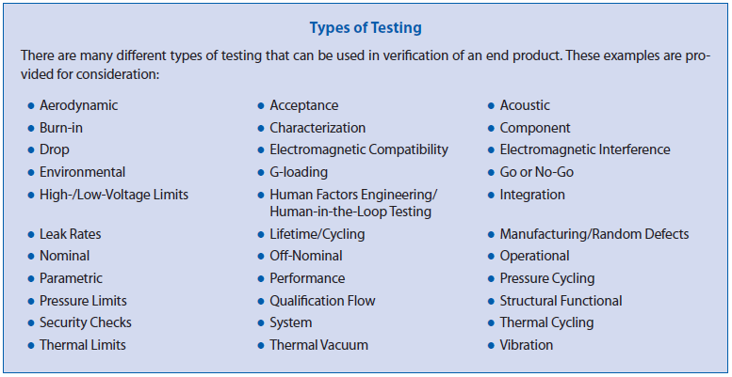
Types of Verification Tests

Slide 10
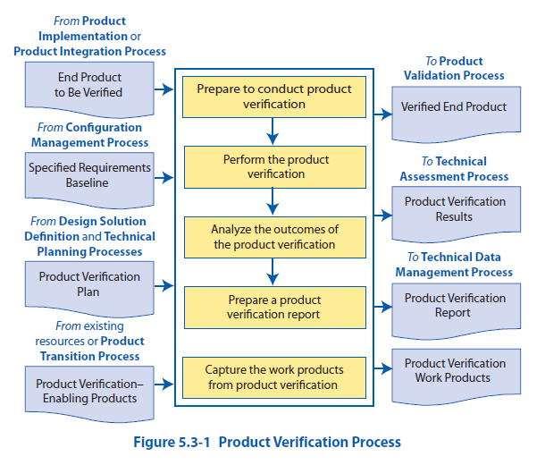

Slide 11
Steps of the Verification Process (1/2)
Step | Outcomes
1. Verification Planning | - Verification method(s) for each requirement is/are selected - Procedures for each type of verification are written & success criteria is clear - Facilities/test equipment are available (vibe table, TVAC chamber, etc)
2. Verification Preparation | - Requirements for the product are identified - Test articles are identified and ready (don’t always test flight unit, can test engineering units)
3. Conduct Verification | - Verification data is collected for each requirement - (Initial) determination about whether the product meets all requirements (may require further analysis to be sure)

Slide 12
Steps of the Verification Process (2/2)
Step | Outcomes
4. Analyze Verification Results | - Anomalies or out-of-compliance conditions identified - Determination on discrepancies (waiver, re-test, re-work, etc) -Corrective actions (as required)
5. Capture Verification Work Products | - Verification report is developed and includes: Assumptions Set of requirements to be verified Test description, details on test configuration Test data Results of each requirement verification, including pass/fail adjudication Comments on anomalies, corrective actions Lessons learned - Complete any other supporting documentation

Slide 13
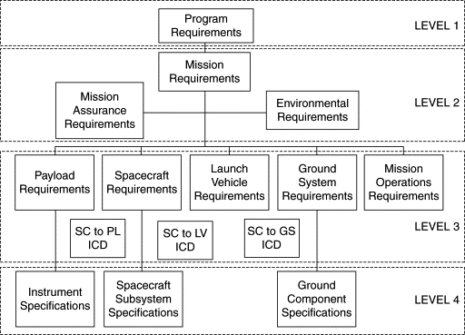
Requirements Flowdown

Slide 14
End-to-End System Testing
Objective: to demonstrate interface compatibility and desired total functionality among different elements of a system, between systems, and within a system as a whole
Includes:
Testing all elements of the architecture (to the extent feasible), to include the spacecraft, communications architecture, ground system software, command & control system, appropriate stimulation, and data processing
Executing operational scenarios, to ensure the entire system meets mission requirements (a level up from spacecraft requirements)
Idea is to Test Like You Fly

Slide 15
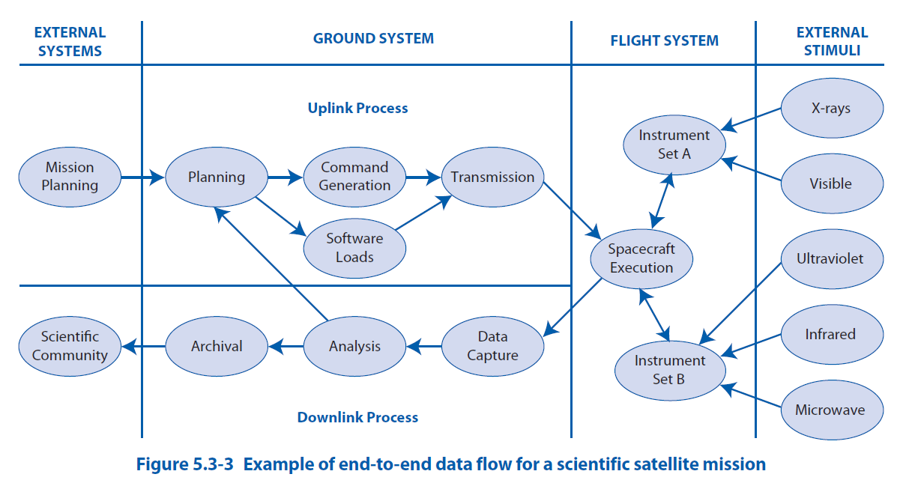
End-to-End System Test Example

Slide 16
Validation Process (1/2)
Objective: confirms that realized end product was realized, can be used by intended operators/users, and measures of effectiveness (MOEs) are satisfied
Key Outputs:
Validated product
Discrepancy reports and identified corrective actions
Validation report
*MOEs: measures of how well system meets its mission requirements, from stakeholder point of view

Slide 17
Validation Process (2/2)
Success Criteria:
Objective evidence of performance and the results of each validation activity are documented
Closure of all discrepancy reports

Slide 18
Validation Process Steps
*Basically same as verification, just with validation in mind instead (comparing performance to MOEs and ConOps rather than specification requirements)
1. Validation Planning
2. Validation Preparation
3. Conduct Validation
4. Analyze Validation Results
5. Capture Validation Work Products

Slide 19
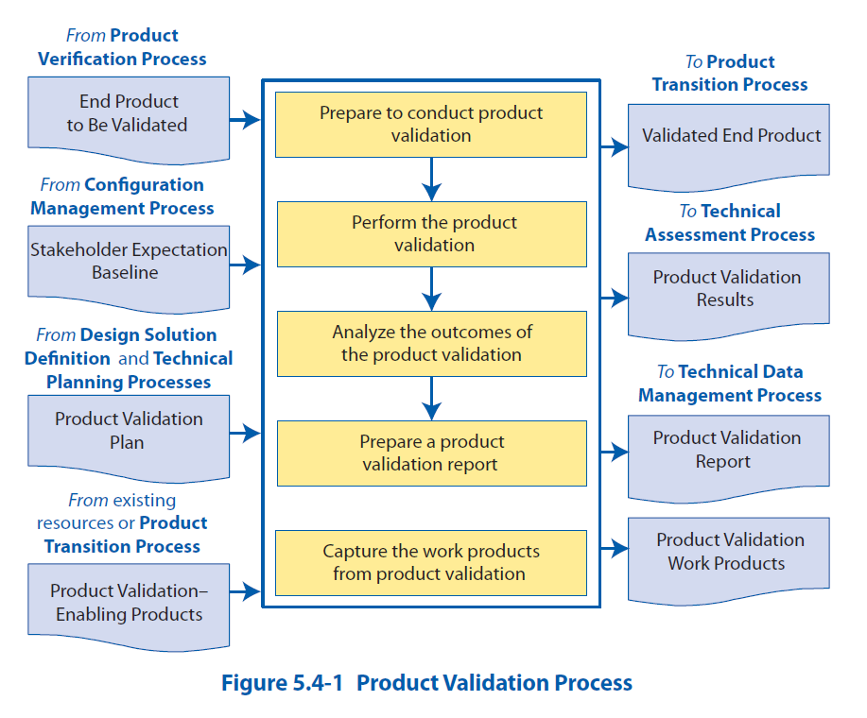

Slide 20
Root Cause Anaylsis

Slide 21
Root Cause Analysis
Definition: process of identifying all the causes (root causes and contributing causes) that may have generated an undesirable condition, nonconformity or failure
Why?
Helps prevent problems from re-occuring
When to use RCA?
Undesirable condition, defect or failure is detected and cause is unknown

Slide 22
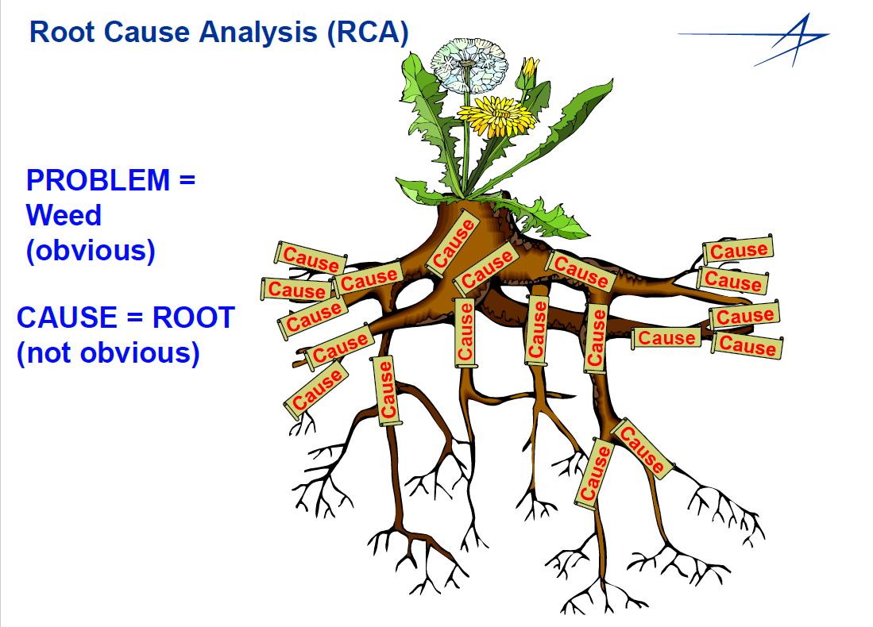

Slide 23
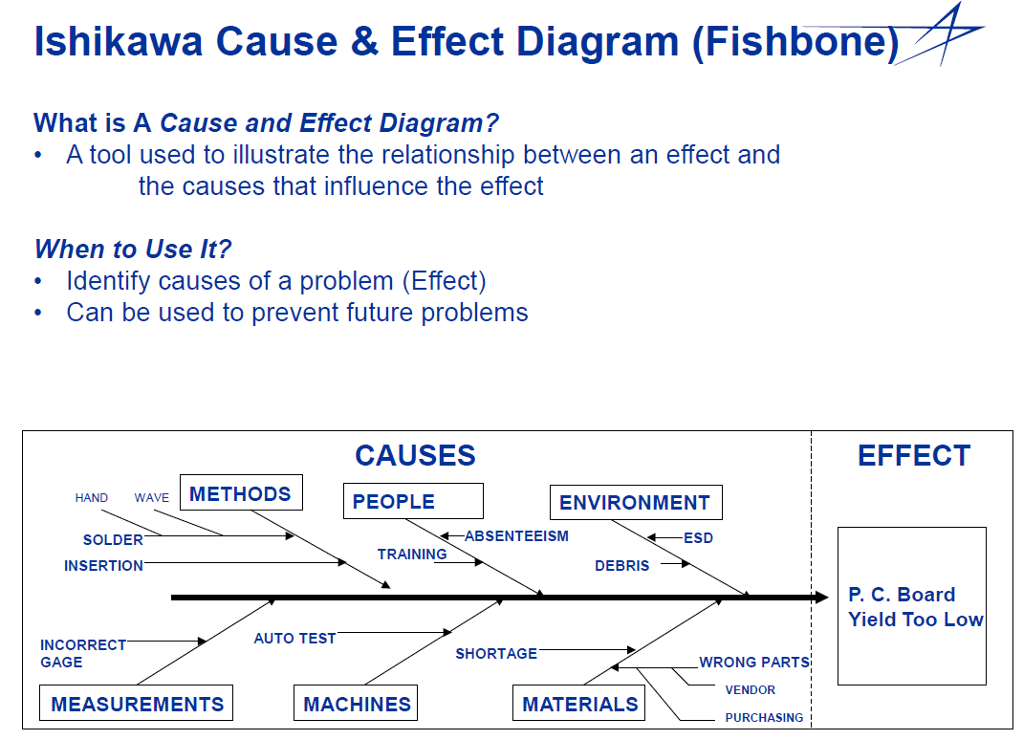

Slide 24
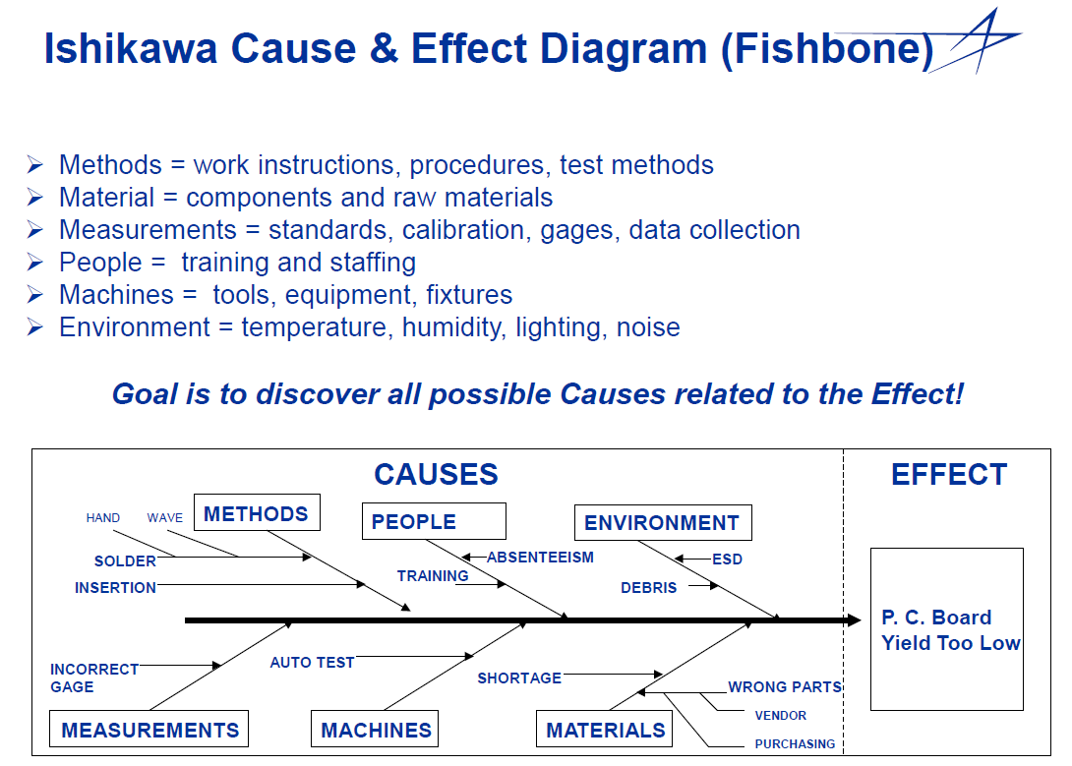

Slide 25
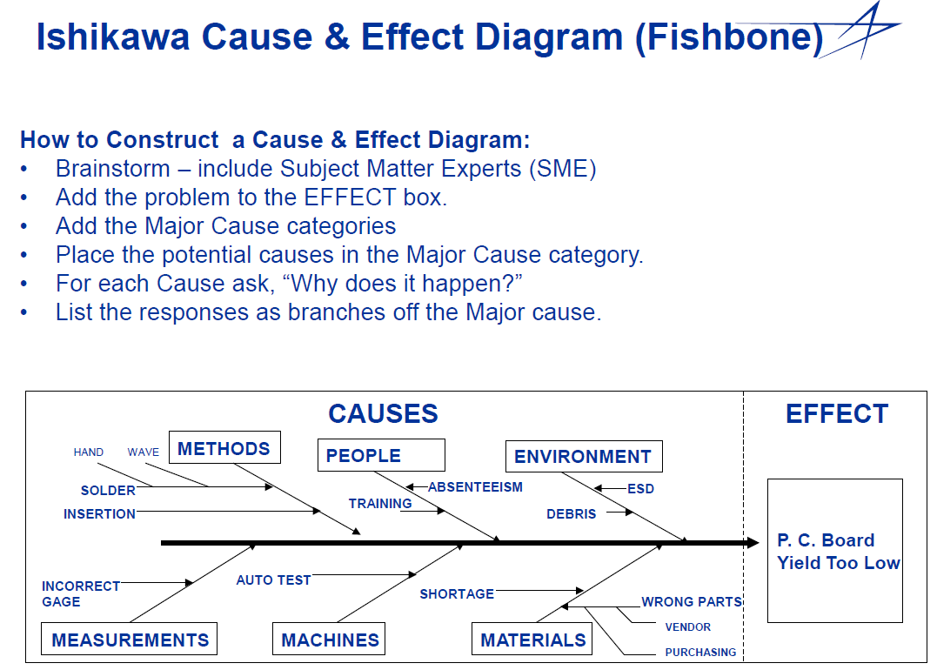

Slide 26
How to interpret an Ishikawa Diagram?
Look for causes that appear frequently
Reach a team consensus
Determine the relative frequencies of the different causes
Once you’ve identified a root cause(s), then what? → Corrective Action
Action taken to eliminate cause of nonconformance in order to prevent recurrence

Slide 27
Ishikawa “Fishbone” Diagram
One method of root cause analysis
Advantages | Disadvantages
- Encourages brainstorming - Helps organize many potential causes | - May not capture all of causes that do not fit into a prescribed category - No guidance for prioritizing causes or developing solutions - Doesn’t delve into root cause of each cause

Slide 28
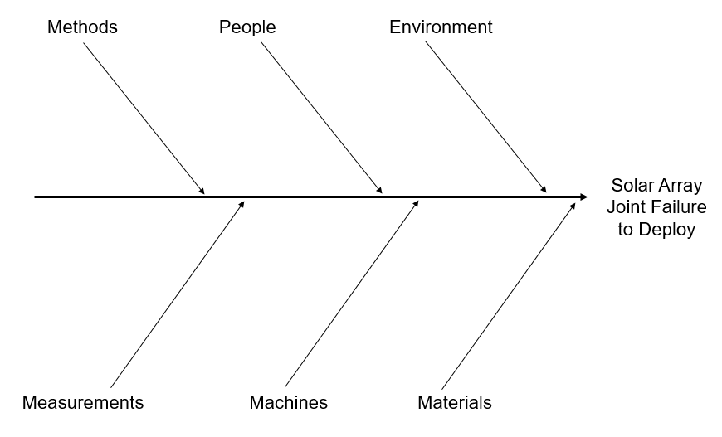
Example
You are the lead test engineer executing a test for the ADCS subsystem of a new scientific mission for NASA. The test is in a clean room, at ambient temperature and pressure. You notice that the inertial measurement units are reporting unexpected data. You stop the test and call in the lead ADCS engineer for help in creating a fishbone diagram. After you complete the fishbone diagram, discuss your corrective actions. Support your conclusions.
Unexpected data from inertial measurement units

